Slide 1




CODESTACKERS
HACKTOBERFEST 1.0

Slide 2






Problem statement
It's important to you and your community because it helps fix problems quickly, making things safer and more convenient..
2. Efficient issue resolution saves the community money, which can benefit the target audience in the form of lower taxes or improved services.

Slide 3




Solution
Our website helps people to report and map community issues like water or electricity problems can make life better in your neighborhood. It also helps everyone work together, saves money, and keeps your community safe and connected..

Slide 4


Key Features and Functionality
Report Issues: Easily report community problems such as water and electricity issues through the website.
Real-Time Mapping: View the reported issues on a map for quick identification and resolution.
Community Collaboration: Encourage residents to collaborate, making the community safer and more efficient.
4.Problem Filtering: Users can filter problems by location and status.(It allow for easy identification of patterns and trends in community problems)

Slide 5


Social impact
The use of social media data in disaster and crisis management is increasing rapidly. Particularly in connection to flooding events, water quality issues in ponds/lakes, urban flooding, and drainage problem, etc., can provide situational awareness to emergency responders. Discussion about such events can also be found on various social media platforms.
.

Slide 6


Safety and Well-being: Your service contributes to a safer and more secure community by swiftly
Revenue Model
1.A revenue model for a website should include multiple sources of income like advertising revenue, marketing, sponsorship and brand deals. It is important to consider the target audience.
2. By various income sources, a website can increase its revenue potential and ensure long-term sustainability.

Slide 7



Technologies Used
pP
front end:HTML,CSS,js
Backend:Mongodb,Moongoose,Node.js AS WELL AS TOOLS LIKE GITHUB and GPS-tracking location .
PROGRAMMING LANGUAGES: PYTHON , JAVA
FRONT END: HTML , CSS , JS
BACK END: Mongodb, Mongoose , Node.js
As well as GITHUB and GPS Tracker.

Slide 8

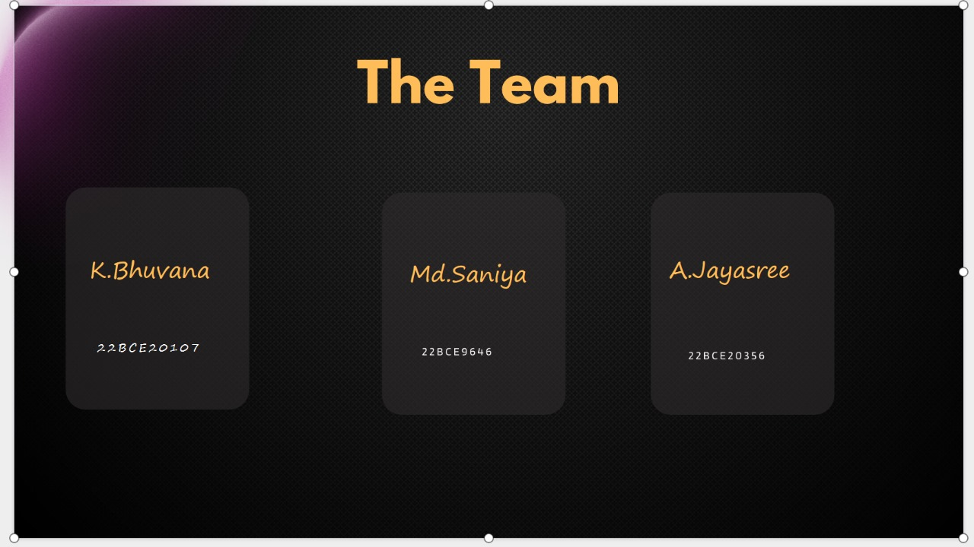
The Team
K.Bhuvana
Md.Saniya
A.Jayasree
22BCE20107
22BCE9646
22BCE20356
l

Slide 9


Thank You
HACKTOBER FEST

